Slide 1
EQUIPMENT & OUTREACH
TRAILERS, TOOLKITS, AND TRAINING
Notes:
RC presenting

Slide 2
AGENDA
Listos Program Updates
  2023 Opportunity - Clearinghouse
  2021 Review – RC’s & Past grantees
Equipment & Outreach
  Safety
  Outreach mini teach
Facilitated discussion
Notes:
RC Presenting

Slide 3
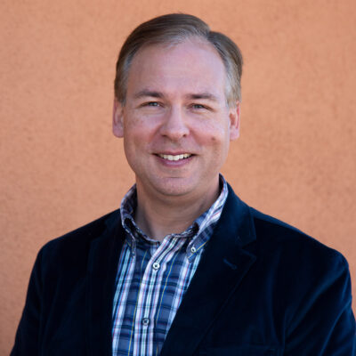
CFSC CLEARINGHOUSE INTRODUCTION
Thomas Shumaker
Staff Grants Specialist
Tshumaker@cafiresafecouncil.org
            Has been with CFSC since 2020
            Has a background in federal, state, and locally funded grants and the field of history.
            Lives in Davis, CA, with his son, Alexander (8), an aquarium, and two guinea pigs.
Notes:
Thomas presenting

Slide 4
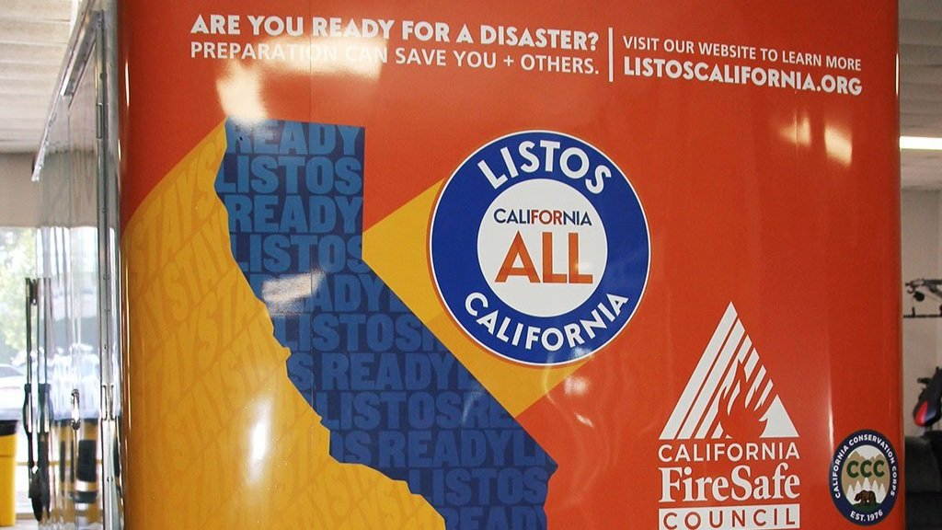
CFSC / LISTOS
California Fire Safe Council partners with LISTOS California to Launch "Outreach Toolkits & Trailers Program" for Wildfire Preparedness in high-risk communities across California
Notes:
Thomas presenting

Slide 5
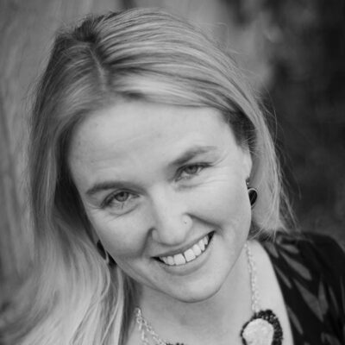
CFSC CLEARINGHOUSE INTRODUCTION
            Has been with CFSC since 2004
            Lives in Sutter Creek, CA on her flower farm with her husband, two kids, and goats
Amber Gardner
Clearinghouse Manager
agardner@cafiresafecounil.org
Thomas Shumaker
Staff Grants Specialist
Tshumaker@cafiresafecouncil.org
            Has been with CFSC since 2020
            Has a background in federal, state, and locally funded grants and the field of history.
            Lives in Davis, CA, with his son, Alexander (8), an aquarium, and two guinea pigs.
Notes:
Thomas presenting

Slide 6
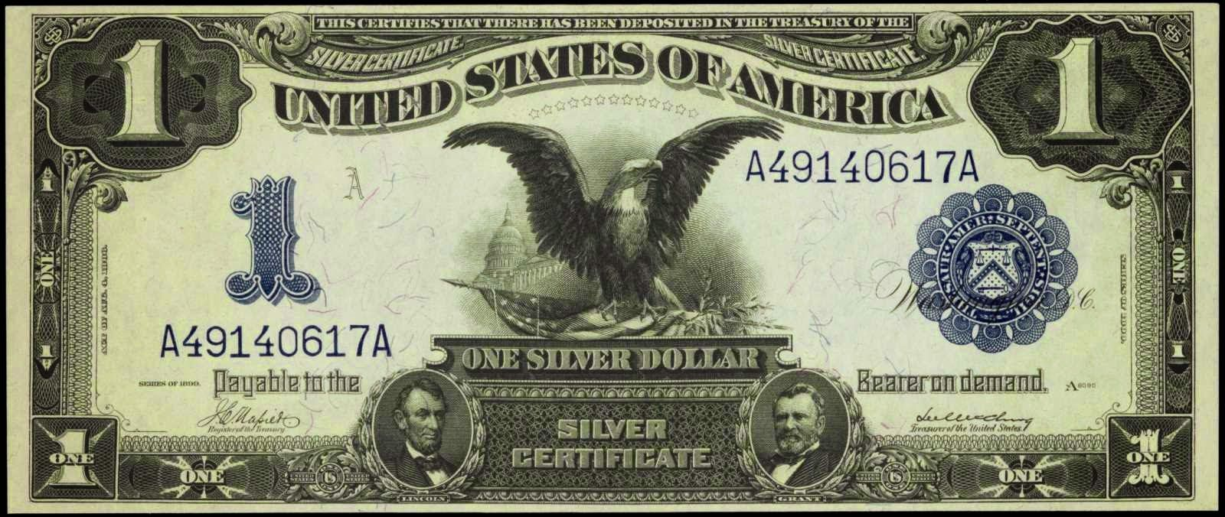
TRAILER AND STIPEND
Trailers will be both cache for:
Wildfire preparedness projects in home hardening and defensible space.
Storage for outreach materials, including:
The LISTOS California Program Materials;
  CFSC brochures on Home Hardening, Defensible Space, and other wildfire preparedness material;
  outreach supplies, such as folding table, bin for supplies, folding chairs, and signage.
Notes:
Thomas Presenting
3 trailers 5 k stipend

Slide 7
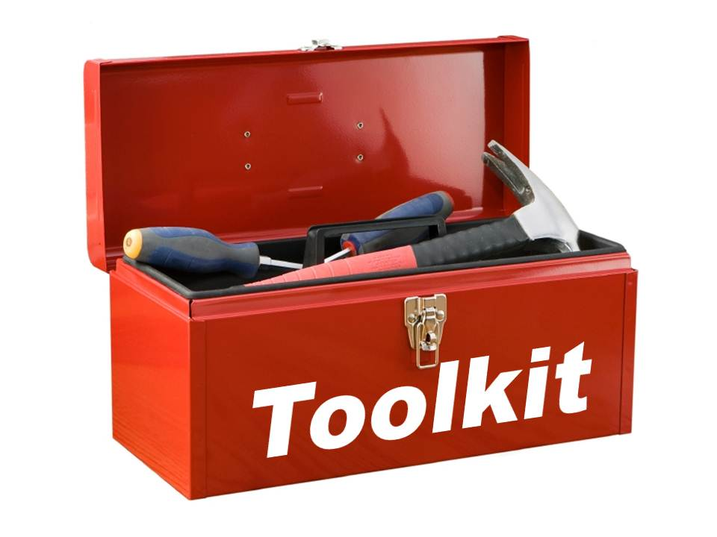
TOOLKIT AND STIPEND
Subgrantees will be provided with outreach kits that:
  Implement outreach and education
  Help with training activities for wildfire disaster preparedness, response, recovery, and mitigation.
LISTOS California Program Materials
  Training by CFSC on how to implement their preparedness efforts
  Listos Disaster Readiness Brochures available for order on our website in 5 languages
Notes:
Thomas Presenting
6 outreach kits 3 k stipend

Slide 8

CFSC / LISTOS
CAL OES/LISTOS RESOURCES
LISTOS California has free materials in many languages that you can use and share to promote disaster preparedness in your home and community.
Pack a Go bag Activity with Bookmark
Disaster puzzle / Memory game
Quick Guide to Extreme Heat
Quick guide to Power Outages
Quick Guide to Wildfire Smoke
Stay Safe after a Wildfire
Stay Safe After a Power Outage
Summer of Safety –Stay Safe in a Wildfire
Summer of Safety- Stay safe in Wildfire Smoke
5 Steps to Preparedness Coloring sheet
Personal Documents Checklist
California Wildfire Preparedness Social Media Toolkit
Disaster Recovery Resources Guide
There Are Videos Too!
LISTOS Videos
Notes:
RC’s Presenting

Slide 9
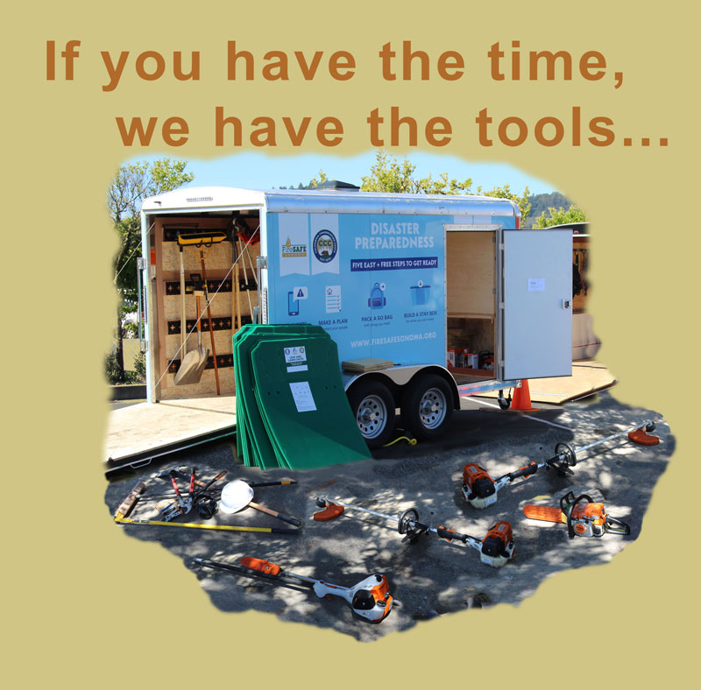
LISTOS TRAILERS PROJECTS
Notes:
Guest Speaker

Slide 10
HOME HARDENING & DEFENSIBLE SPACE
LISTOS Trailer Program Mendocino FSC Success Stories:
  https://www.youtube.com/watch?v=DL-VnB8IKAg
Notes:
RC present/sara assist

Slide 11
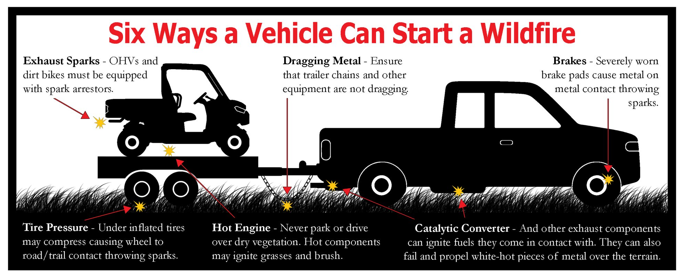
VEHICLES AND EQUIPMENT SAFETY
Notes:
RC Present

Slide 12
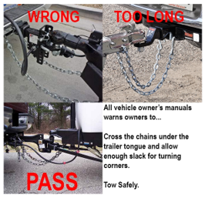
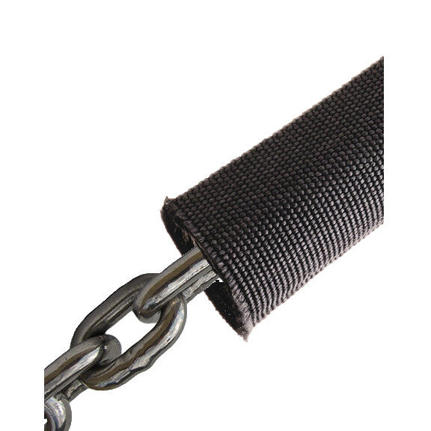

OUTREACH MINI TEACH
Trailer Towing Safety Tips
July is Equipment Safety Month through CWCG
  When towing any trailer utilize the following safety considerations:
    Chain Covers (One less spark):
    Twist and Cross Chains:
    Check Tires, Wheels, Barings, Brakes:
Notes:
RC Present

Slide 13
EQUIPMENT & PROGRAM DISCUSSION
What do you envision to be your FSC’s needs?
  Equipment funding?
  Project management?
  Equipment training?
How can CFSC assist with filling those needs?
  Training, Certifications, network opportunities?
  Grant writing webinar?
What are the groundbreaking project needs?
  CEQA/NEPA/EIR’s?
  Manpower?
  Equipment ?
Notes:
RC Present

Slide 14
LISTOS! REQUIREMENTS AND EXPECTATIONS
All subgrantees will be required to complete the following activities:
Participate in 1 post award webinar to review subgrant project deliverables, funding stipulations, data collection/reporting requirements, and deadlines.
Participate in 1 CFSC-hosted training webinar on how to integrate LISTOS California Program materials into their program and outreach efforts.
Attend quarterly subgrantee meetings for peer-to-peer learning and submit quarterly programmatic progress reports.

Slide 15
LISTOS! REQUIREMENTS AND EXPECTATIONS
Host 1 conversation to identify disaster preparedness needs of their community for integration into local county emergency plans.
Conduct a minimum of 1 outreach event during the project period.
Create a minimum of 1 online post (via social media or website) to promote wildfire preparedness using the LISTOS California strategies/framework.
Trailer grantees will be required to implement at least one defensible space and/or home hardening event utilizing the trailer.

Slide 16

LISTOS! REQUIREMENTS AND EXPECTATIONS
To ensure subgrantees meet deliverables, a CFSC grant specialist will provide technical assistance for data collection and grants management to subawardees during pre-application period, post-award webinar, and through ongoing support as needed.

Slide 17

LISTOS! REQUIREMENTS AND EXPECTATIONS
Technical assistance and training for programmatic activities (including education, training, planning, and capacity building) to be provided by Regional Coordinators and Outreach & Communications staff through training webinars, quarterly subgrantee meetings, site visits (1 per grantee), and ongoing support as needed based on programmatic performance.

Slide 18

LISTOS! REQUIREMENTS AND EXPECTATIONS
Through ongoing communication and coordination of subgrantees by the CFSC regional coordinators , CFSC will work with the communities to identify existing gaps for diverse and vulnerable populations on disaster preparedness and propose solutions to strengthen local emergency plans accordingly.

Slide 19
QUESTIONS? ANSWERS!
For further programmatic questions please reach out to Thomas Shumaker, LISTOS Grant Specialist
Or our Regional Coordinators:
Britney, Brooke, or Mike
Notes:
RC Present

